Slide 1

Inferential statistics
Binomial probability distributions
This Photo by Unknown Author is licensed under CC BY

Slide 2
Section 2. Binomial Distributions

Slide 3
Section 2. Objectives
How to determine whether a probability experiment is a binomial experiment
How to find binomial probabilities using the binomial probability formula
How to find binomial probabilities using technology, formulas, and a binomial probability table
How to construct and graph a binomial distribution
How to find the mean, variance, and standard deviation of a binomial probability distribution

Slide 4
Binomial Experiments
The experiment is repeated for a fixed number of trials, where each trial is independent of other trials.
There are only two possible outcomes of interest for each trial. The outcomes can be classified as a success (S) or as a failure (F).
The probability of a success,
is the same for
each trial.
The random variable x counts the number of successful trials.

Slide 5
Notation for Binomial Experiments
Symbol | Description
n | The number of times a trial is repeated
p | The probability of success in a single trial
q | The probability of failure in a single trial left parenthesis q = 1 minus p right parenthesis
x | The random variable represents a count of the number of successes in n trials: x = 0, 1, 2, 3, ellipsis, n.

Slide 6
Possible Applications for the Binomial Distribution
A manufacturing plant labels items as either defective or acceptable.
A firm bidding for contracts will either get a contract or not.
A marketing research firm receives survey responses of “yes I will buy” or “no I will not.”
New job applicants either accept the offer or reject it.

Slide 7
Example: Identifying and Understanding Binomial Experiments (1 of 2)
Decide whether each experiment is a binomial experiment. If it is, specify the values of n, p, and q, and list the possible values of the random variable x. If it is not, explain why.
A certain surgical procedure has an 85% chance of success. A doctor performs the procedure on eight patients. The random variable represents the number of successful surgeries.

Slide 8
Solution: Identifying and Understanding Binomial Experiments (1 of 3)
Binomial Experiment
Each surgery represents a trial. There are eight surgeries, and each one is independent of the others.
There are only two possible outcomes of interest for each surgery: a success (S) or a failure (F).
The probability of a success,
is 0.85 for each
surgery.
The random variable x counts the number of successful surgeries.

Slide 9
Solution: Identifying and Understanding Binomial Experiments (2 of 3)
Binomial Experiment
n = 8 (number of trials)
p = 0.85 (probability of success)
(probability of failure)
x = 0, 1, 2, 3, 4, 5, 6, 7, 8 (number of successful surgeries)

Slide 10
Example: Identifying and Understanding Binomial Experiments (2 of 2)
Decide whether each experiment is a binomial experiment. If it is, specify the values of n, p, and q, and list the possible values of the random variable x. If it is not, explain why.
A jar contains five red marbles, nine blue marbles, and six green marbles. You randomly select three marbles from the jar, without replacement. The random variable represents the number of red marbles.

Slide 11
Solution: Identifying and Understanding Binomial Experiments (3 of 3)
Not a Binomial Experiment
The probability of selecting a red marble on the first trial is
Because the marble is not replaced, the probability of
success (red) for subsequent trials is no longer
The trials are not independent and the probability of a success is not the same for each trial.

Slide 12
Binomial Probability Formula
Binomial Probability Formula
The probability of exactly x successes in n trials is
n = number of trials
p = probability of success
x = number of successes in n trials
Note: number of failures is

Slide 13

Example: Finding a Binomial Probability
Rotator cuff surgery has a 90% chance of success. The surgery is performed on three patients. Find the probability of the surgery being successful on exactly two patients. (Source: The Orthopedic Center of St. Louis)

Slide 14
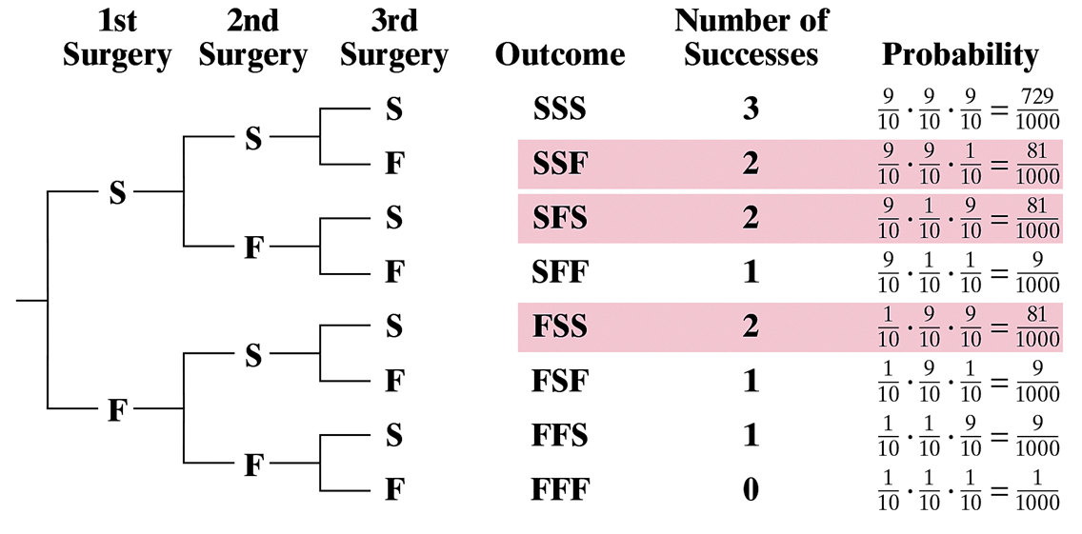
Solution: Finding a Binomial Probability (1 of 2)
Method 1: Draw a tree diagram and use the Multiplication Rule.
Notes:
The tree diagram has the following sections, first surgery, second surgery, third surgery, outcome, number of successes, and probability. The root node branches into S and F at the first surgery. The S branches into S and F at the second surgery, where the S branches into S and F at the third surgery. The F at second surgery branches into S and F at the thirds surgery. The F at first surgery branches into S and F at the second surgery, where the S branches into S and F at the third surgery. The F at second surgery branches into S and F at the thirds surgery. The outcomes, number of successes, and probability, are as follows. Outcome, S S S, number of successes, 3, Probability 9 tenths times 9 tenths times 9 tenths = start fraction 729 over 1000 end fraction. Outcome, S S F, number of successes 2, Probability 9 tenths times 9 tenths times 1 tenth = start fraction 81 over 1000 end fraction. Outcome, S F S, number of successes 2, Probability 9 tenths times 1 tenth times 9 tenths = start fraction 81 over 1000 end fraction. Outcome, S F F, number of successes 1, Probability 9 tenths times 1 tenth times 1 tenth = start fraction 9 over 1000 end fraction. Outcome, F S S, number of successes 2, Probability 1 tenth times 9 tenths times 9 tenths = start fraction 81 over 1000 end fraction. Outcome, F S F, number of successes 1, Probability 1 tenth times 9 tenths times 1 tenth = start fraction 9 over 1000 end fraction. Outcome, F F S, number of successes 1, Probability 1 tenth times 1 tenth times 9 tenths = start fraction 9 over 1000 end fraction. Outcome, F F F, number of successes 0, Probability 1 tenth times 1 tenth times 1 tenth = start fraction 1 over 1000 end fraction.

Slide 15
Solution: Finding a Binomial Probability (2 of 2)
Method 2: Use the binomial probability formula.

Slide 16
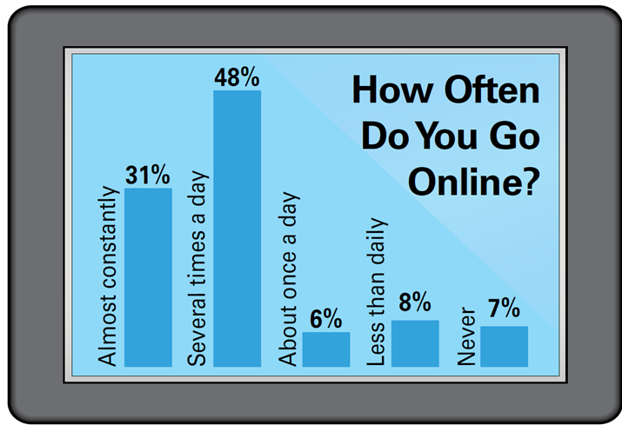
Example: Constructing a Binomial Distribution
In a survey, U.S. adults were asked how often they go online. The results are shown in the figure. Six adults who participated in the survey are randomly selected and asked whether they go online several times a day. Construct a binomial probability distribution for the number who respond that they go online several times a day. (Source: Pew Research)

Slide 17
Solution: Constructing a Binomial Distribution (1 of 2)
p = 0.48 and q = 0.52
n = 6, possible values for x are 0, 1, 2, 3, 4, 5 and 6

Slide 18
Solution: Constructing a Binomial Distribution (2 of 2)
Notice in the table that all the probabilities are between 0 and 1 and that the sum of the probabilities is about 1.
x | P of x
0 | 0.020
1 | 0.109
2 | 0.253
3 | 0.311
4 | 0.215
5 | 0.079
6 | 0.012
Blank | sum of P of x = 0.999

Slide 19
Example: Finding a Binomial Probabilities Using Technology
A survey found that 75% of U.S. adults are experiencing digital device fatigue. (This is the state of mental exhaustion caused by concurrent and excessive use of digital devices such as smartphones and tablet computers.) You randomly select 100 adults. What is the probability that exactly 66 are experiencing digital device fatigue? Use technology to find the probability. (Source: The Harris Poll)

Slide 20
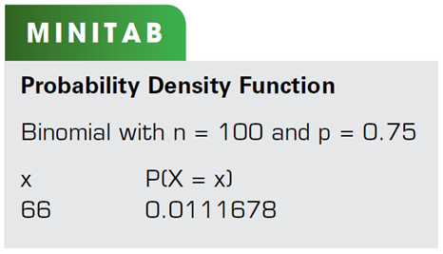
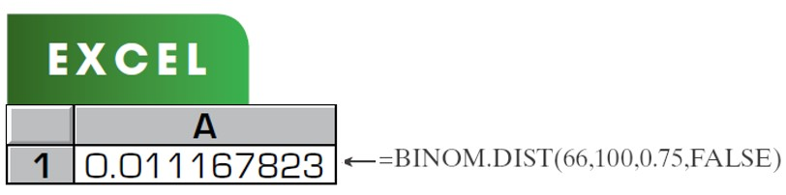
Solution: Finding a Binomial Probabilities Using Technology (1 of 2)
Solution
Minitab, Excel, have features that allow you to find binomial probabilities. Try using these technologies. You should obtain results similar to these displays.

Slide 21
Solution: Finding a Binomial Probabilities Using Technology (2 of 2)
Solution
From these displays, you can see that the probability that exactly 66 adults are experiencing digital device fatigue is about 0.011. Because 0.011 is less than 0.05, this can be considered an unusual event.

Slide 22
Example: Finding Binomial Probabilities Using Formulas
A survey found that 22% of U.S. adults say that the economy, unemployment, and jobs are the most important problems facing the U.S. today. You randomly select four adults and ask them whether the economy, unemployment, and jobs are the most important problems facing the U.S. today. Find the probability that (1) exactly two of them respond yes, (2) at least two of them respond yes, and (3) fewer than two of them respond yes. (Source: Ipsos)

Slide 23
Solution: Finding Binomial Probabilities Using Formulas (1 of 4)
Solution
Using n = 4, p = 0.22, q = 0.78, and x = 2, the probability that exactly two adults will respond yes is

Slide 24
Solution: Finding Binomial Probabilities Using Formulas (2 of 4)
Solution
To find the probability that at least two adults will respond
yes, find the sum of
Begin by using the binomial probability formula to write an expression for each probability.

Slide 25
Solution: Finding Binomial Probabilities Using Formulas (3 of 4)
Solution
So, the probability that at least two will respond yes is

Slide 26
Solution: Finding Binomial Probabilities Using Formulas (4 of 4)
Solution
To find the probability that fewer than two adults will
respond yes, find the sum of
So, the probability that fewer than two will respond yes is

Slide 27
Example: Finding a Binomial Probability Using a Table
About 5% of workers (ages 16 years and older) in the United States commute to their jobs by using public transportation (excluding taxicabs). You randomly select eight workers. What is the probability that exactly three of them use public transportation to get to work? Use a table to find the probability. (Source: American Community Survey)
Solution:
Binomial with n = 8, p = 0.05, x = 3

Slide 28
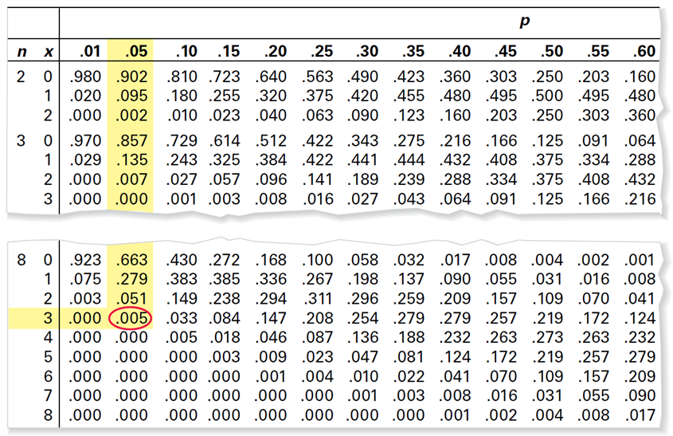
Solution: Finding Binomial Probabilities Using a Table (1 of 2)
A portion of Table 2 is shown
According to the table, the probability is 0.005.
Notes:
The column headings, from left to right, are as follows. N, x, 0.01, 0.05, 0.10, 0.15, 0.20, 0.25, 0.30, 0.35, 0.40, 0.45, 0.50, 0.55, 0.60. The p values in the column for p = 0.05 are highlighted. The row entries for n = 8 and x = 3 are highlighted until p = 0.005. The following values are highlighted. 0.902, 0.095, 0.02, 0.857, 0.007, 0.000, 0.663, 0.279, 0.051, 0.005. The row entries highlighted are as follows. n = 8, x = 3, 0.000, 0.005. The values 0.005 is encircled.

Slide 29
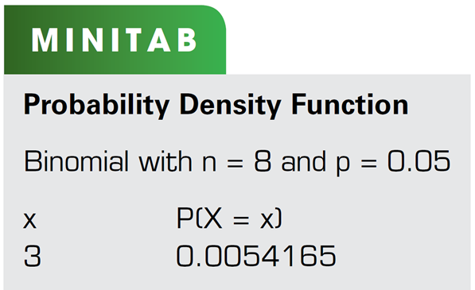
Solution: Finding Binomial Probabilities Using a Table (2 of 2)
You can check the result using technology.
So, the probability that exactly four of the eight workers carpool to work is 0.005. Because 0.005 is less than 0.05, this can be considered an unusual event.

Slide 30
Example: Graphing a Binomial Distribution
Sixty-four percent of people who have survived cancer are ages 65 years or older. You randomly select six people who have survived cancer and ask them whether they are 65 years of age or older. Construct a probability distribution for the random variable x. Then graph the distribution. (Source: American Cancer Society)
Solution:
n = 6, p = 0.64, q = 0.36
Find the probability for each value of x

Slide 31
Solution: Graphing a Binomial Distribution (1 of 2)
x | 0 | 1 | 2 | 3 | 4 | 5 | 6
P of x | 0.002 | 0.023 | 0.103 | 0.245 | 0.326 | 0.232 | 0.069
Notice in the table that all the probabilities are between 0 and 1 and that the sum of the probabilities is 1.

Slide 32
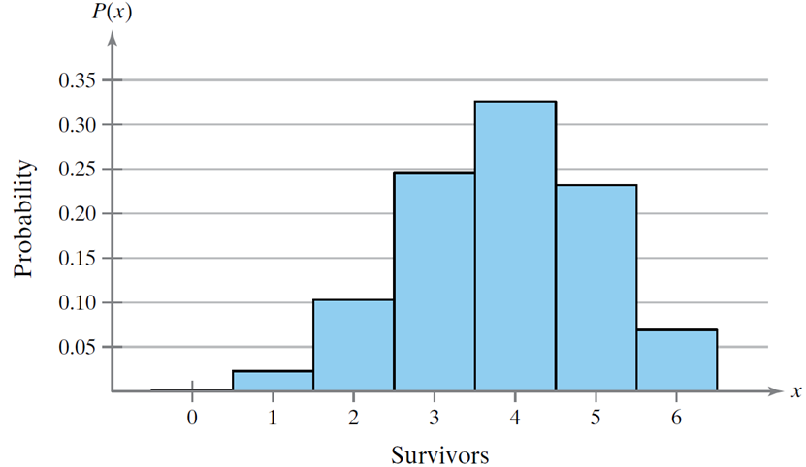
Solution: Graphing a Binomial Distribution (2 of 2)
Histogram:
People Who Have Survived Cancer, 65 Years of Age or Older
From the histogram, you can see that it would be unusual for none or only one of the survivors to be age 65 years or older because both probabilities are less than 0.05.
Notes:
The horizontal axis ranges from 0 to 6 in increments of 1. The vertical axis ranges from 0.05 to 0.35 in increments of 0.05. The data plotted are as follows. (0, 0.01), (1, 0.025), (2, 0.10), (3, 0.24), (4, 0.33), (5, 0.23), and (6, 0.06). All values are estimated.

Slide 33
Mean, Variance, and Standard Deviation
Mean:
Variance:
Standard Deviation:

Slide 34

Example: Mean, Variance, and Standard Deviation
In Pittsburgh, Pennsylvania, about 56% of the days in a year are cloudy. Find the mean, variance, and standard deviation for the number of cloudy days during the month of June. Interpret the results and determine any unusual values. (Source: National Oceanic and Atmospheric Administration)
Solution: n = 30, p = 0.56, q = 0.44
Mean:
Variance:
Standard Deviation:

Slide 35

Solution: Mean, Variance, and Standard Deviation
On average, there are 16.8 cloudy days during the month of June.
The standard deviation is about 2.7 days.
Values that are more than two standard deviations from the mean are considered unusual.
A June with 11 cloudy days or
less would be unusual.
A June with 23 cloudy days or
more would also be unusual.

